Slide 1


Final IDEA
Team 3:
Timothy van der Steenhoven
Saskia van der Velden
Emmanuel Bakare
Notes:
Final idea for the NS challenge.
Present the idea of the lamp creat by team 3, Timothy, Saskia and Emannuel.

Slide 3
Table of contents
Introduction
The “Product”
Problem
Needs
Solution

Slide 4
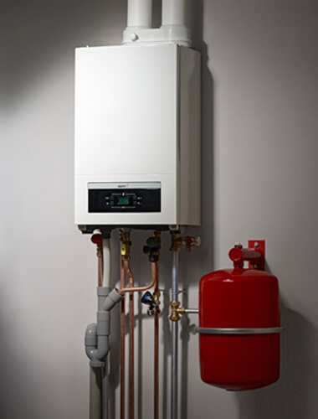
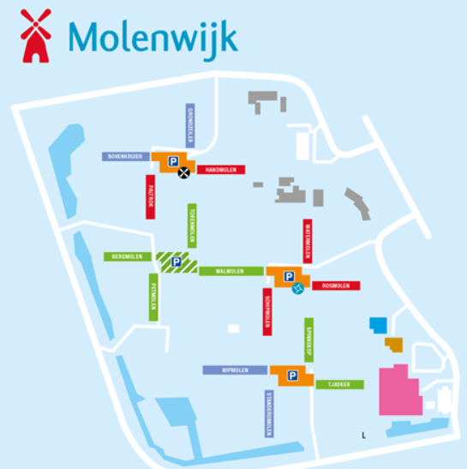

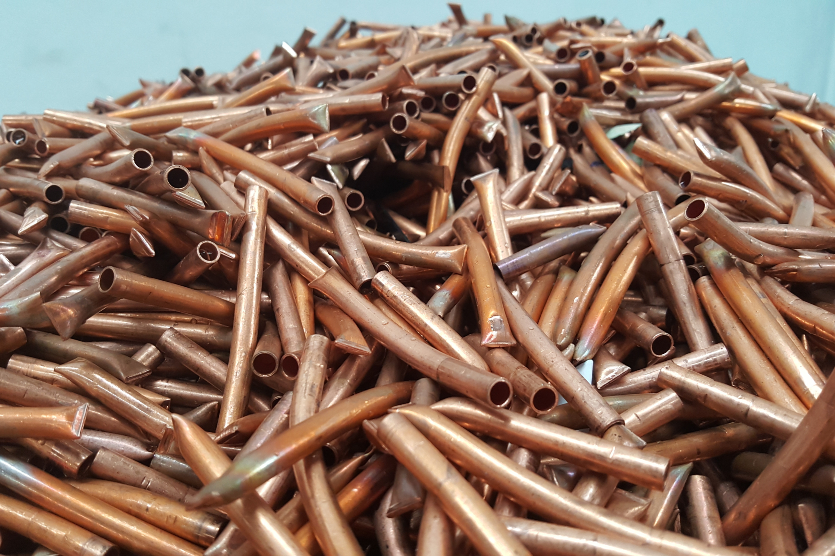
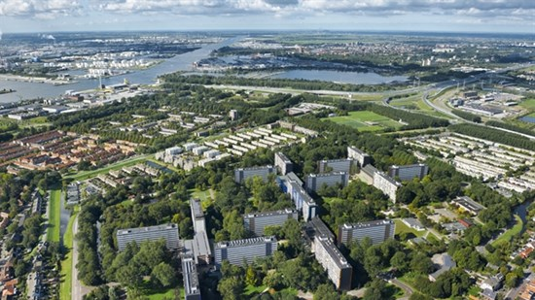
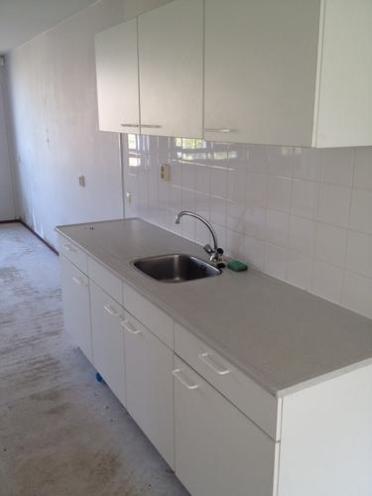
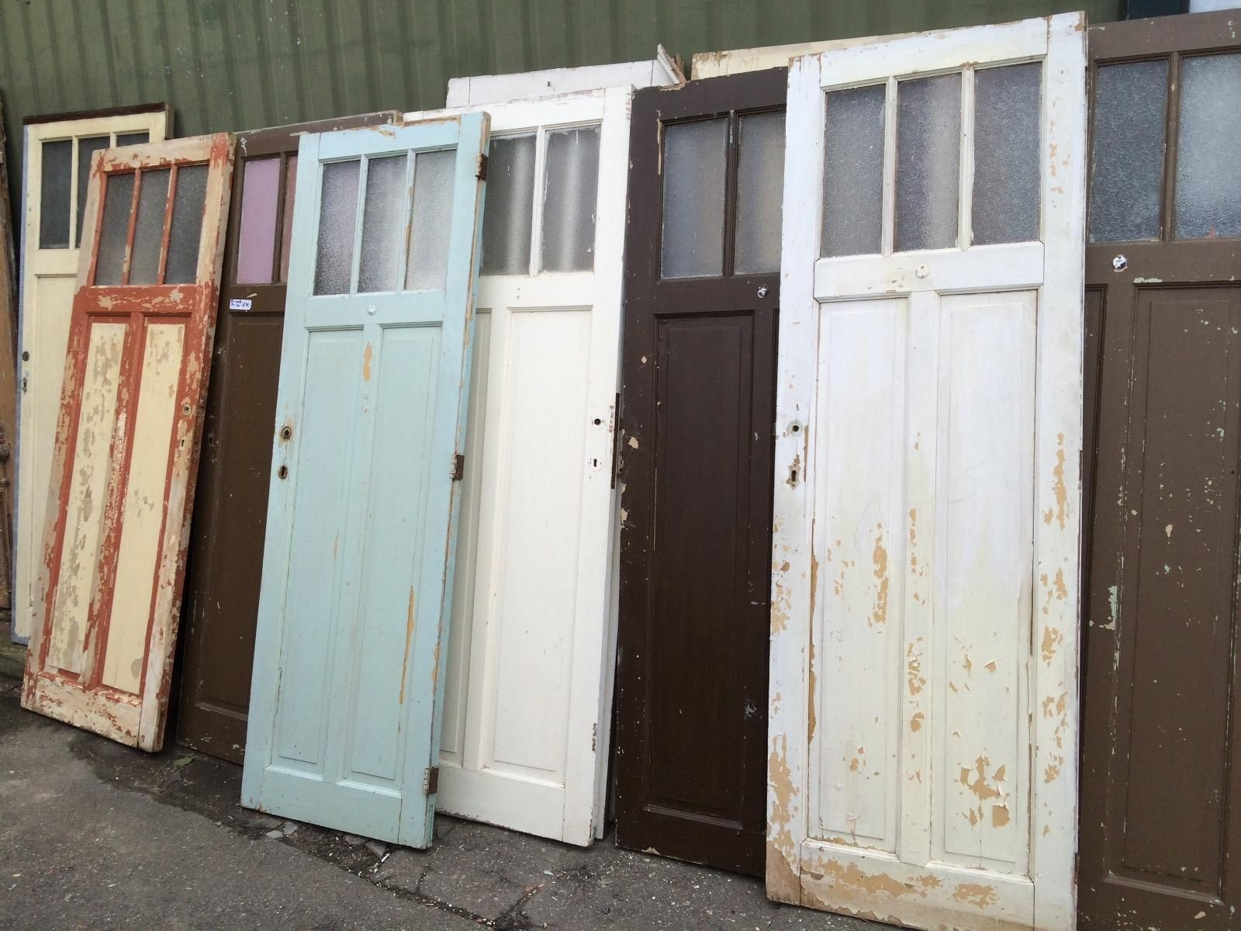
Introduction The NS Circular Challenge
60.000 apartments in total
For example: Molenwijk

Slide 5
The “product”
Problem
Needs
Solution
Studying at night
Bad lighting
Scared of the dark
Ligthbulb
Electrical wire
Switch(es)
Lamp

